Slide 1
"Black Arts" Index Maintenance #1
How the “Best Practice” Methods are Silently Killing Performance
Jeff Moden
SQL Saturday #830- Colorado Springs, CO
06 April, 2019

Slide 2
"Black Arts" Index Maintenance #1
How the “Best Practice” Methods are Silently Killing Performance
Jeff Moden
SQL Saturday #830- Colorado Springs, CO
06 April, 2019

Slide 3

Your Speaker – Jeff Moden
22 years experience working with SQL Server
Started out as an “Accidental DBA”
Mostly Self Taught
One of Leading Posters on SQLServerCentral.com
Member since 2003
More than 47,000 posts (heh… some are even useful)
33 articles on the “Black Arts” of T-SQL
Coined the term "RBAR" (Row By Agonizing Row)
Helped make the "Tally Table" a household name
9 Year SQL Server MVP Veteran
Winner of the Red Gate “Exceptional DBA” award for 2011
Frequent speaker at PASS Chapters and SQL Saturdays.
Lead Application and part-time systems DBA, Data Architect, and SQL Mentor for Proctor Financial, Inc.
SQL Server is both my profession and my hobby
(Yeah, I know… I need to get a life ;-)

Slide 4
Special Thanks and Acknowledgement
Brent Ozar
https://www.brentozar.com/
Paul Randal and Kimberly Tripp
https://www.sqlskills.com/
Steve Jones and various SQL "Ninjas" too numerous to list
http://www.sqlservercentral.com/
Ed Wagner
Good friend and early adopter that has provided incredible feedback and insight.

Slide 5
Assumptions

Slide 6
You Should Already Be Familiar with These Things
What an index is and what it's used for.
Clustered (RowStore)
Non-Clustered (RowStore)
Be familiar with the term "Fragmentation" as it pertains to indexes.
What a "Fill Factor" is.
What an "Index Rebuild" is.
What an "Index Reorganize" is.
How to use sys.dm_db_index_physical_stats.

Slide 7
What's in the Zip File
Goodies!

Slide 8

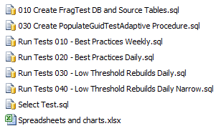
Zip File: GUID Tests for BA#1
Create Tables & Data
Common Test Proc
Multiple Test Runs
For Each File
Multiple SELECT Tests
Line Charts

Slide 9
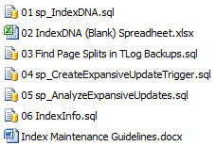
Zip File: Tools
See What Indexes
REALLY Look Like
Find Splitting Headaches
Find and Analyze "ExpAnsive" Updates
Like sys.dm_db_index_physical_stats on Steroids
Some Handy Fill Factor Guidelines

Slide 10
GUID Tests for BA#1 (folder)
010 Create FragTest DB and Source Tables.sql
Creates the FragTest data base and test tables.
dbo.GuidSource table
Random GUIDs for all tests except BASELINEs.
Random order preserved by RowNum.
dbo.GuidSourceSorted table
Sorted GUIDs for BASELINEs.
Same GUIDs as in GuidSource but sorted.
Sorted order preserved by RowNum.
dbo.IxPageStats table
Contains test results by hour.
Test Name, Fragmentation, Insert Durations, Defrag Type and Duration, etc.

Slide 11
GUID Tests for BA#1 (folder)
The is no script "020".
030 Create PopulateGuidTestAdaptive Procedure.sql
Creates the dbo.PopulateGuidTestAdaptive stored procedure.
Provides a standard interface for all test runs.
Populates the table under test.
Does hourly measurements.
Does end-of-day measurements and defrags according to parameters.
Records defrag info.

Slide 12
GUID Tests for BA#1 (folder)
Run Tests 010 - Best Practices Weekly.sql
123 byte index
BPWK_FFnnn where "nnn" = 070, 080, 090, or 100
Also contains the "narrow" Baseline and "narrow" NoDefrag run.
Run Tests 020 - Best Practices Daily.sql
123 byte index
BPDD_FFnnn where "nnn" = 070, 080, 090, or 100

Slide 13
GUID Tests for BA#1 (folder)
Run Tests 030 - Low Threshold Rebuilds Daily.sql
123 byte index
LTDD_FFnnn where "nnn" = 070, 080, 090
Run Tests 040 - Low Threshold Rebuilds Daily Narrow.sql
24 byte index
NLTDD_FFnnn where "nnn" = 070, 080, 090
Also contains the "narrow" Baseline and "narrow" NoDefrag run.

Slide 14
A Bit of History
"We have met the enemy…
… and he is us." (Walt Kelly, circa 1970)

Slide 15
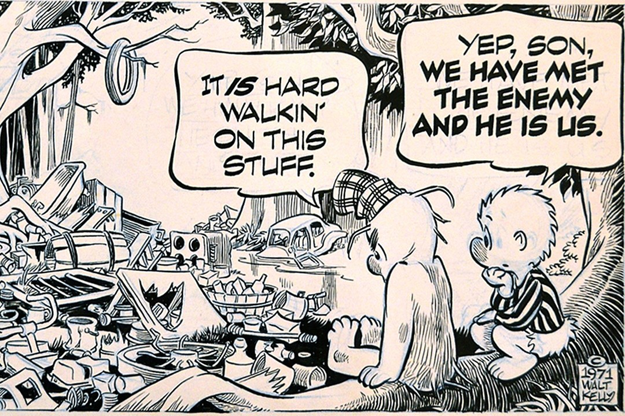
Pogo Comic Strip by Walt Kelly
POGO Hair

Slide 16
Events Leading Up to this Presentation
Jan 2015:
Learned of Brent Ozar's unusual technique for Index Maintenance.
Didn't implement it because…
It violated every "Best Practice" I knew.
I thought it wouldn't work.
https://www.brentozar.com/archive/2012/08/sql-server-index-fragmentation/
https://www.brentozar.com/archive/2013/09/why-index-fragmentation-doesnt-matter-video/

Slide 17
Events Leading Up to this Presentation
Jan 2016:
System was suffering major blocking every Monday for 3 months.
Only daily difference was that Index Maintenance was done on Sunday nights.
Implemented Brent's unusual method for Index Maintenance based on a "Sherlock Holmes" guess.
HALLELUJAH! It worked! No blocking on the following Monday! Performance improved a bit each day (but didn't have the time to find out why)!
CPU usage dropped from 22% to 8% over 3 months and stayed there ever since.

Slide 18
Events Leading Up to this Presentation
Nov 2017:
Setting up for huge data deletions.
DBCC SHRINK FILE was going to require some "index maintenance".
Thought back to the blocking issue and Brent's unusual method of Index Maintenance.
Didn't want to go through the blocking problem again.
Particularly concerned because Brent's unusual method for Index Maintenance was to…

Slide 19

Brent's Unusual Method Is To…
STOP DOING ANY INDEX MAINTENANCE!

Slide 20
Raised More Questions than I Had Answers For
Why did "Best Practices" Index Maintenance cause massive blocking?
Why did not doing any Index Maintenance work so well?
What problems do each of those methods cause?
Is there a better way?
OMG!!! YES!!!

Slide 21
Goals for Session #1
Understand the main problem:
Page Splits
Related performance problems.
Demonstrate how and why current "Best Practices" Index Maintenance can cause…
Perpetual Page Splits
Perpetual Fragmentation
Perpetual performance problems.
The perpetual need for Index Maintenance.
Demonstrate Brent's unusual technique of not doing any index maintenance and why it worked.
Introduction to a better way.
Only RowStore indexes will be covered.

Slide 22
Goals for Session #1
To be honest…
There is NOTHING new in this presentation.
EVERYTHING about this presentation is covered in Books Online.
EVERYTHING about this presentation has been covered in multiple articles and blogs.
The BIG difference is…
We're going to see it all in a whole new way.

Slide 23
Page Splits
When Data is Added

Slide 24
What is a "Page Split"?
SQL Server stores data on 8KB pages.
When a page becomes full and we need to add more data, a new page must be created.
Doesn't matter if it's a Clustered or Non-Clustered index.
Exception: A page split on a Clustered Index can cause page splits on the Non-Clustered Indexes (not covered in this presentation).

Slide 25
Causes of Page Splits
"Mid-Index Inserts"
Logical order is enforced.
"ExpAnsive Updates"
If row gets wider for variable width datatypes.
Can Selects and Deletes cause page splits?
Yes. Lazy spools in the execution plan can be subject to page splits (out of scope).
Deletes do leave empty space on data pages (Physical Fragmentation / Page Density).
There are two types of Page Splits…
Good (which are kind of bad)
Bad (which are really bad)

Slide 26
Why the Emphasis on Page Splits?
They are the primary cause of LOGICAL FRAGMENTATION.
They are the primary cause of PHYSICAL FRAGMENTATION.
Except for DELETEs, they are the primary reason to do expensive index maintenance!
Cause of many hidden performance problems due to blocking and writes to the log file.
Cause of wasted resources
Memory.
Disk space.
Transaction Log file activity and backup size.

Slide 27
Why the Emphasis on Page Splits?
Bad Page Splits cause 4.5 to 43 times more log file usage (log file writes and all that goes with them)!
Great articles by Paul Randal.
https://www.sqlskills.com/blogs/paul/how-expensive-are-page-splits-in-terms-of-transaction-log/
https://www.sqlskills.com/blogs/paul/performance-issues-from-wasted-buffer-pool-memory/
In reality, I've found that "43 times worse" is an understatement.

Slide 28
Good Page Splits
A "Good" Page Split is the addition of one new page at the logical end of an index ("Append Only").
Each new page causes at least one new row to be added to the B-Tree with an occasional new page added.
Lightweight and easy on the log.
Very fast transactions.
They cause NO FRAGMENTATION!
They still take extra time and resources.
1
2
3
4
5
6
The B-Tree must be updated prior to committing the system transaction.
A new index fills up a page and a new page must be created.
A system transaction is started and the page is locked.
A new page is added.
The new page and the previous page are doubly linked
When the new page is filled up…
…the process repeats itself over and over for each new page

Slide 29
Bad Page Splits Inserts and/or ExpAnsive Updates
Occur in the "middle" of the index.
Everything is fully logged at the row level!
More rows per page makes the logging worse!
And then the B-Tree is updated and logged along with frequent splits of its own.
Pages not released until transaction commits.
There's not enough room for the new row and so the transaction is extended to the next logical page.
SQL Server starts a system transaction on the page and checks it for space.
Transaction
Transaction
1
2
3
3
4
5
6
New
The links between the two existing pages are dropped.
Finally, the new row is added in to the page.
SQL Server will insert a new row on a page in the correct logical order… Page 3, in this case.
All pages are doubly linked to each other.
About half the rows are moved from the target page to the new page.
6 pages…
Filled to capacity
Pages 3 and 3A suffer "Physical" Fragmentation because they are no longer full.
Pages 3, 3A, and 4 are all part of "Logical Fragmentation"
New links are created between the existing pages and the new page.
An existing empty page is found or a new one is created.
Empty
Page
3A

Slide 30
Test Data for the "Worst" Data-Type for Index Keys
Everyone usually agrees…
Random GUIDs are the "Worst".
Other index types covered in 2nd session.

Slide 31
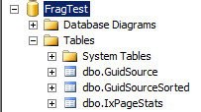
Test Tables (010 Create FragTest DB and Source Tables.sql)
3.65 Million GUID rows
Random GUIDs
Same GUIDs Sorted
Results

Slide 32
Stored Procedure (030 Create PopulateGuidTestAdaptive Procedure.sql)
Start
1,000 Individual Row Inserts per Hour
10 Hours per Day
365 Days
3.65 Million Rows Total for Each Run
Day Counter
1 to 365
Record Frag
Hour = 00
& Defrag Dur
Hour Counter
1 to 10
Measure
Fragmentation
Insert 1,000 rows for hour
RBAR
Defrag?
N
Record Insert Duration
Y
Defrag
the Index
Bump the Day Counter
Record Fragmentation
Note
Defrag Dur
N
Days Done?
Bump the Hour Counter
Y
Hours Done?
N
Y
Stop

Slide 33
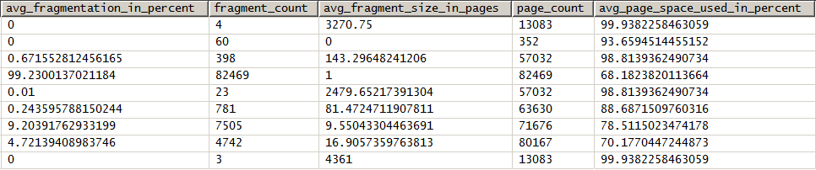
Measuring Fragmentation and Page Splits
sys.dm_db_index_physical_stats
"Logical" Fragmentation
(Low number is good)
Logical Order vs Physical Order of Pages.
Page_Count
This is what we'll be measuring "Page Splits" with.
"Physical" Fragmentation
(High number is good)
How full pages currently are.
(Page Density)
https://docs.microsoft.com/en-us/sql/relational-databases/system-dynamic-management-views/sys-dm-db-index-physical-stats-transact-sql

Slide 34
Effects of "Best Practice" Index Maintenance on GUIDs
A Splitting Headache

Slide 35
Traditional/Best Practice Index Maintenance "Rules"
Page Count <= 1,000 Pages.
No Index Maintenance
Page Count > 1,000 Pages
Check avg_fragmentation_in_percent
< 5-10% : No Index Maintenance
BETWEEN 5-10% and 30% : Reorganize
> 30% : Rebuild

Slide 36
Best Practice - Weekly Defrag Ever Increasing Sorted Insert
Any Increase in Page Count is due to:
Page Splits Good or Bad but virtually ALL bad except for Baseline.
Index Rebuilds (No Reorgs) Will produce nearly vertical increases (NOT Page Splits).
Any Decrease in Page Count due to:
Reorg
Rebuild
All "Good" Page Splits
(NO Fragmentation)
Day Labels at beginning of "Sunday".
Vertical Lines 1 Day on 5 Week charts 1 Week on 1 Year charts

Slide 37
Remember
ALL page splits are bad…
… Even the "Good" ones.

Slide 38
Best Practice - Weekly Defrag The Horror of 100% Fill Factor
Sudden drop in page count is due to defragmentation.
No Room on pages caused massive Page Splits
all day Monday!!!.
No Defrag until 1,000 pages.
Creates "Natural FILL FACTOR"
TONS OF BLOCKING!!!
Virtually All "BAD" Page Splits

Slide 39
Best Practice - Weekly Defrag The ARE "Hints to be had"!
"Flats" are where NO Page Splits Occurred due to the "Natural Fill Factor"
Fragmentation just started!
Virtually All "BAD" Page Splits

Slide 40
Best Practice - Weekly Defrag 90% Fill Factor: Better But…
Less concentrated page splits but still very high numbers and "flats" shorter.
Sudden drop in page count is due to defragmentation.
(All Rebuilds, again)

Slide 41
Best Practice - Weekly Defrag 80% Fill Factor: Better But…
"Flats" after defrag are getting larger. That's good but we still have similar problems.
Still have substantial page splits after the "flats" and that's not good.

Slide 42
Best Practice - Weekly Defrag 70% Fill Factor: Better But…
… we're still getting large numbers of BAD page splits.
"Flats" after REBUILDs are getting larger and reduced page splits.
That's good but…

Slide 43
Best Practice - Weekly Defrag 70% Fill Factor: Interesting…
Note to Self:
Totally Different Pattern than the Rest!

Slide 44
Best Practice - Weekly Defrag Full Year 100% Fill Factor
Fragmentation was always so bad that REBUILDs were ALWAYS done.
The downswings are all REBUILDs!
The upswings are mostly from BAD Page Splits!
Final Week
39,779 Splits
Or 9.47 Bad Splits/Min
First 5 weeks

Slide 45
The Troubles with REORGANIZE
"Also, ALTER INDEX REORGANIZE will compact an index by trying to fill pages to the FILLFACTOR that was last specified. This increases the value in avg_space_used_in_percent. Note that ALTER INDEX REORGANIZE cannot reduce page fullness. Instead, an index rebuild must be performed."
In other words, REORGANIZE removes free space when it's needed the most!
https://docs.microsoft.com/en-us/sql/relational-databases/system-dynamic-management-views/sys-dm-db-index-physical-stats-transact-sql

Slide 46
Best Practice - Weekly Defrag Full Year 90% Fill Factor
Arrows mark Reorgs. Everything else is a Rebuild
Reorgs actually made page splits per minute worse!
1-2 page splits per minute
First 5 weeks

Slide 47
Best Practice - Weekly Defrag Full Year 80% Fill Factor
Arrows mark Reorgs. Everything else is a Rebuild
Reorgs actually made page splits per minute worse!
3 page splits per 2 minutes
First 5 weeks

Slide 48
Best Practice - Weekly Defrag Full Year 70% Fill Factor
Not much difference between 80% and 70% Fill Factor except that Reorgs start sooner and the "flats" are a bit longer.
Note how few REORGs there actually are!
Indexes get "stuck" in the REORGANIZE mode because of data growth.
First 5 weeks

Slide 49
Best Practice - Weekly Defrag Full Year All Fill Factors
Is that the best we can do?
Which is better?
REBUILD is much shorter than REORGANIZE!
First 5 weeks

Slide 50

Maybe it's better to do…
NOTHING!!!
The "Brent Line" (No Defrag)
The "Brent Line" (No Defrag)
First 5 weeks

Slide 51
Best Practice - Daily Defrag Full Year All Fill Factors
NoDefrag is still the overall winner.
NoDefrag created a "Natural Fill Factor" of 68%
Notice that the BASELINE and the "BRENT Line" won't move at all

Slide 52
Does NOT Defragging Indexes Affect Performance?
Absolutely, but not like you'd think.

Slide 53
For INSERTs (so far)…
When following "Best Practices" (Reorg @10%, Rebuild @30%)…
Reorgs actually hurt INSERT performance because they concentrated "Bad" Page Splits by removing free space when we needed it the most.
Not defragging at all provided the best performance and fewest page splits for INSERTs for what we've seen so far because it leaves "free space".

Slide 54
What about SELECTs?
Quote from BOL…
"Fragmentation alone is not a sufficient reason to reorganize or rebuild an index. The main effect of fragmentation is that it slows down page read-ahead throughput during index scans. This causes slower response times. If the query workload on a fragmented table or index does not involve scans, because the workload is primarily singleton lookups, removing fragmentation may have no effect."
https://docs.microsoft.com/en-us/sql/relational-databases/system-dynamic-management-views/sys-dm-db-index-physical-stats-transact-sql

Slide 55
FYI
Next 3 pages come from the code in the ZIP file with the name "Select Test 01".

Slide 56
SELECT of 100,000 Sequential Rows in a JOIN (Merge Join w/Scan)
Fragmentation only matters for things NOT in memory.
Once in memory, fragmentation doesn't matter for speed.
Only page fullness matters.

Slide 57
SELECT of 10,000 Sequential Rows in a JOIN (Loop Join w/Row Seeks)
Fragmentation only matters for things NOT in memory.
Once in memory, fragmentation doesn't matter for speed.
Only page fullness matters.

Slide 58
SELECT of 100,000 Sequential Rows in a Seek/Range Scan
Fragmentation only matters for things NOT in memory.
Once in memory, fragmentation doesn't matter for speed.
Only page fullness matters.

Slide 59
Best Practice - Daily Defrag Full Year All Fill Factors
EVERY THING IS RIDDLED WITH PAGE SPLITS!!!
NoDefrag is still the overall winner.
Do you see anything wrong with this picture???

Slide 60
REORGANIZE
Death by Defragmentation

Slide 61

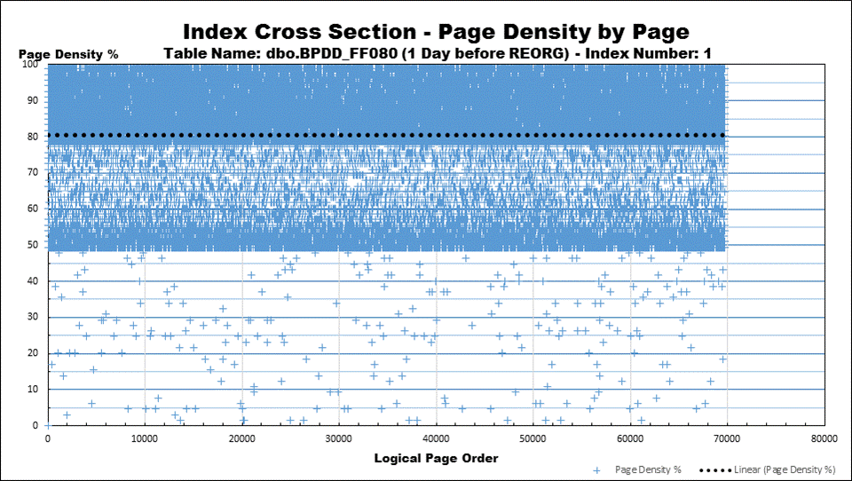
New Type of Chart: Index DNA (sp_IndexDNA)
Actual Percent of Page Fullness
(Page Density)
Renumbered Logical Page Order
(Not actual page numbers)
Each individual "+" sign is an individual page.
The dotted line is the linear average of page fullness.

Slide 62

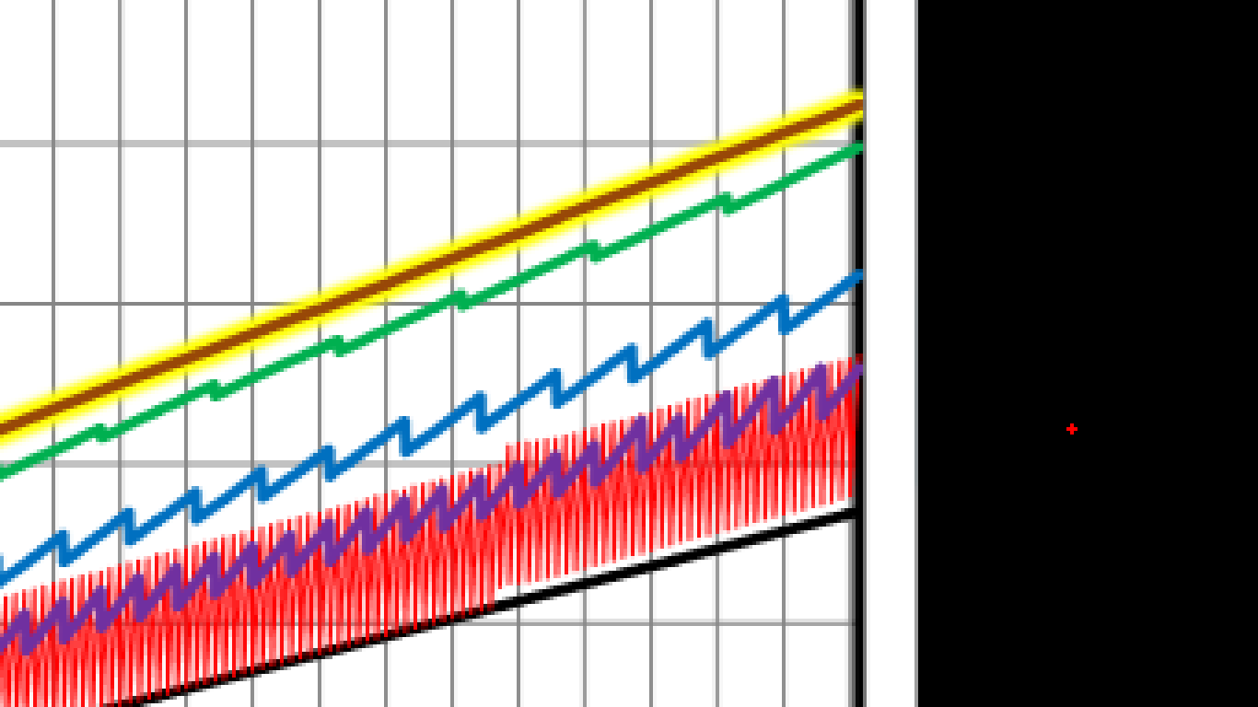
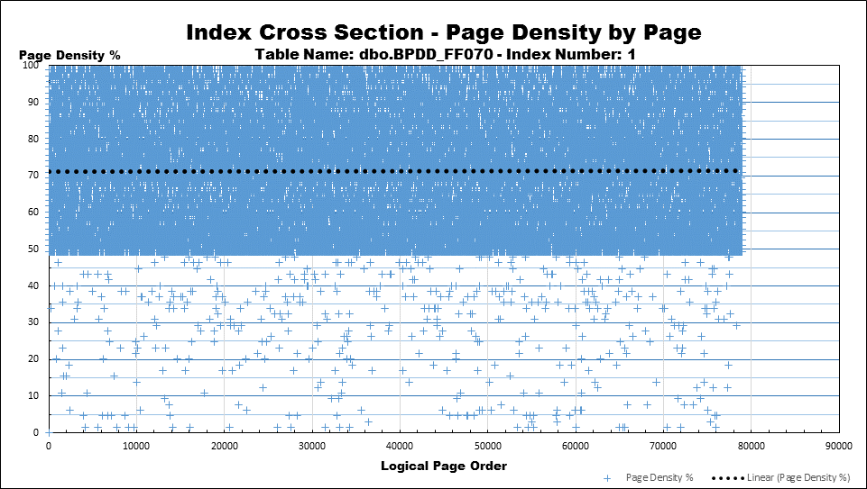
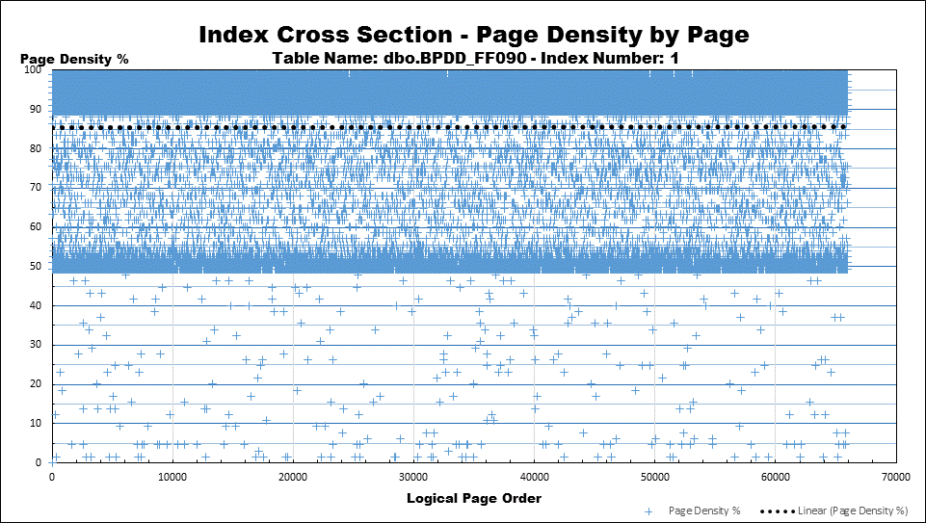
Best Practice Daily 70-80-90 Random GUID/Evenly Distributed
All 3 ended just before Reorg
All 3 BP Fill Factors have a huge number of split pages between 50% and the Fill Factor…
… but the average percent of page fullness will be reported 71, 79, and 85 respectively, which is quite misleading.
10 May 2018 © Copyright by Jeff Moden - All Rights Reserved

Slide 63


Comparison BPDD_FF080 Before and After REORG
Instead, REORGANIZE packed data up to the Fill Factor in an already crowded area that's on the verge of causing Page Splits!
REORGANIZE does NOT add any new pages to allow for better defragmentation or for more growth!

Slide 64
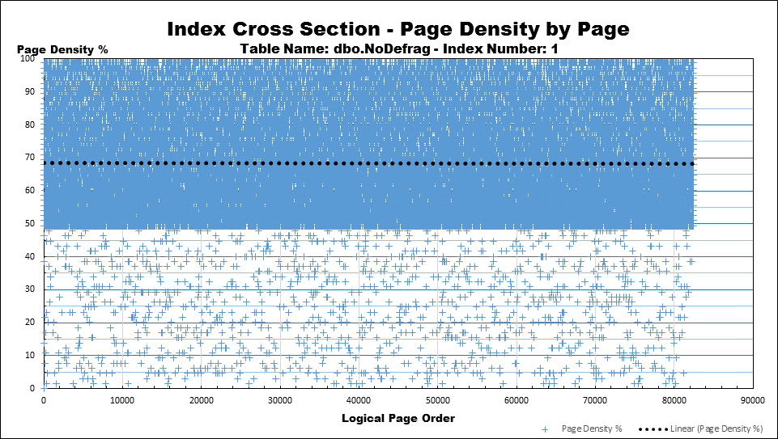
NoDefrag Doesn't look much worse!
More free space in the critical area above the Fill Factor to handle additional INSERTs and ExpAnsive Updates.
Results in fewer Page Splits each day.

Slide 65
Introducing a Better Way
"LOW THRESHOLD REBUILDS"
(GUIDS & Evenly Distributed Indexes)

Slide 66
Best Practice - Daily Defrag Full Year All Fill Factors
EVERY THING IS RIDDLED WITH PAGE SPLITS!!!
NoDefrag is still the overall winner.
Do you see anything wrong with this picture???

Slide 67
Best Practice - Weekly Defrag 70% Fill Factor: Better But…
What if we not only ran REBUILDs more often but…
Rebuilt when splits (fragmentation) first start?
Large "flat"…
Splits just starting...
Rebuild made more room…
Largest Flat So Far!

Slide 68
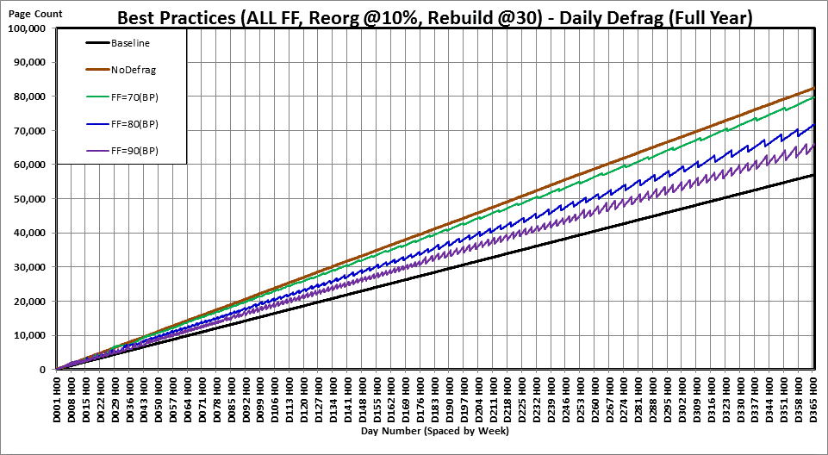
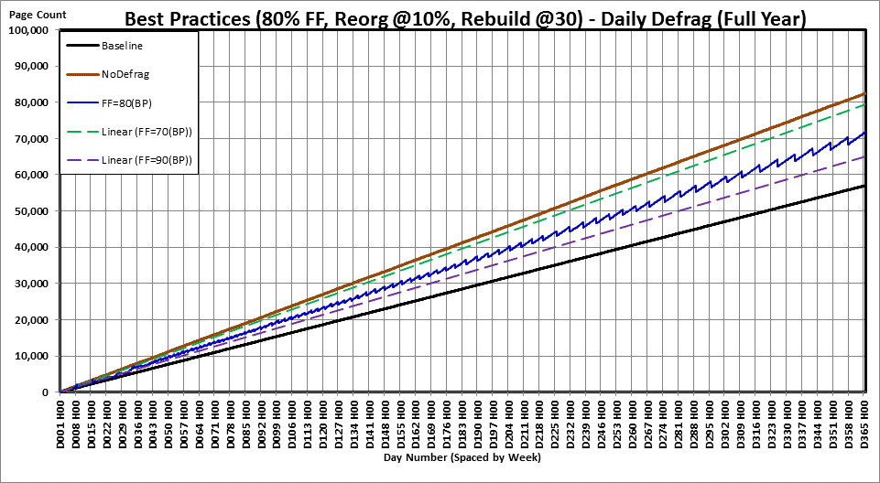
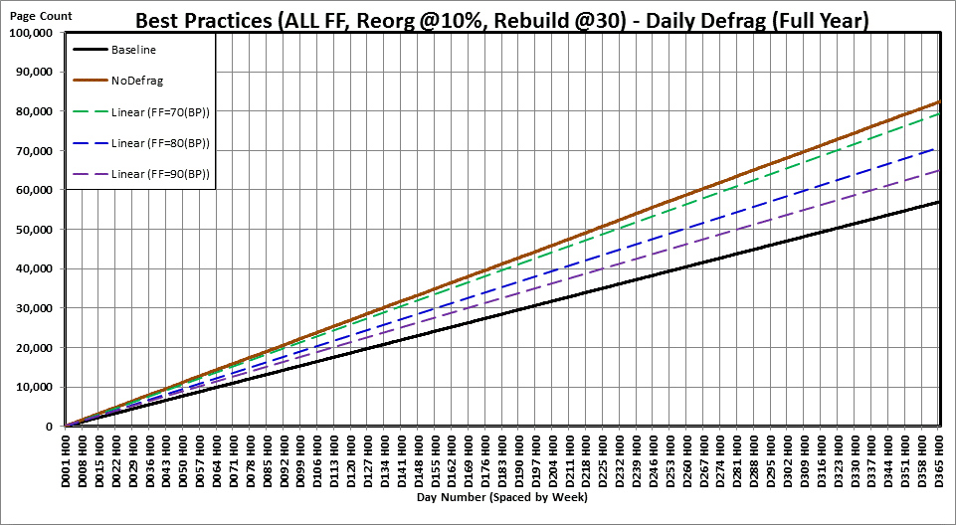
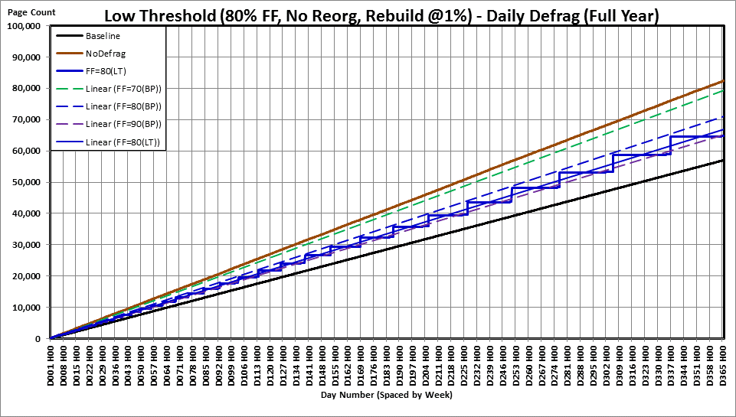
80% Fill Factor Best Practice (GUIDs & Evenly Distributed)
80% Low Threshold Rebuilds
(GUIDS & Evenly Distributed)
Reorgs guarantee page splits WILL happen!
Page Splits
all day
every day!
Virtually NO or super low PAGE SPLITS any day!
Reorgs occur about 3 times a week here.
Rebuilds occur once in 10 days here.
Reorgs occur about once a week here.
Rebuilds occur about 4.5 weeks apart here.

Slide 69
80% Low Threshold Rebuilds (GUIDS & Evenly Distributed)
Low Threshold
Average
80% FF
Best Practice
Average
80% FF
The 80% Low Threshold (LT) Average is very close to the 90% Best Practice (BP) Average for an Average Memory Savings of ~7%
Best Practice
Average
90% FF

Slide 70
80% Low Threshold Rebuilds (GUIDS & Evenly Distributed)
The only time the BP and LT use the same amount of memory is right after an LT rebuild. LT is always lower after that.
You have to go all the way back to here to get to once per week.
The time between rebuilds rapidly gets longer as the size of the table increases.

Slide 71
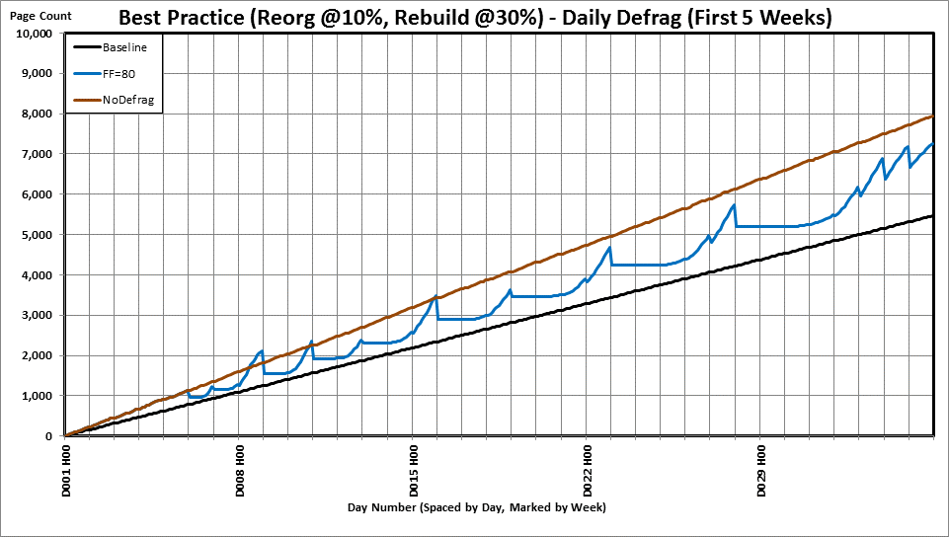
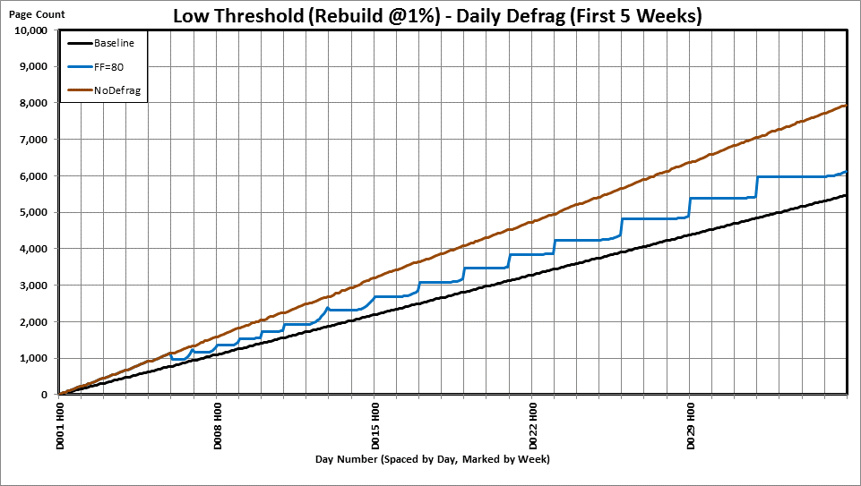
80% Low Threshold Rebuilds (GUIDS & Evenly Distributed)
Now, even the first 5 weeks looks good!
Remember the first 5 BP weeks?

Slide 72
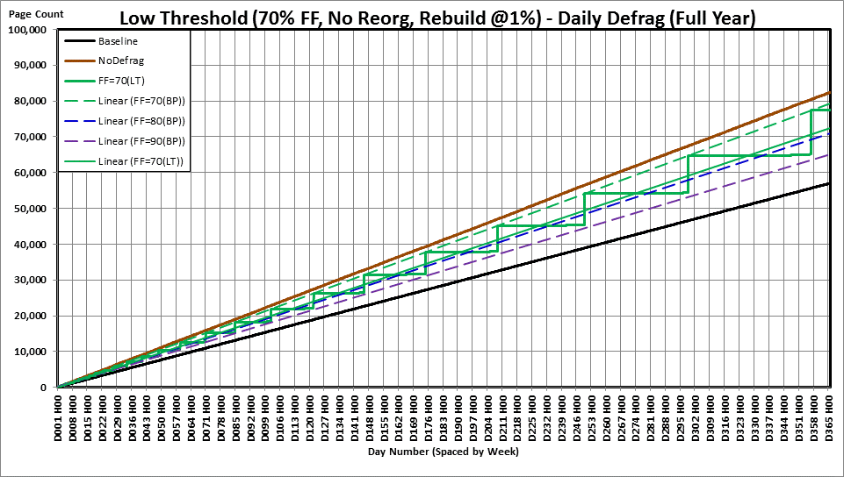
70% Low Threshold Rebuilds (GUIDS & Evenly Distributed)
70% Low Threshold Rebuilds use almost the same memory as 80% BP but have a much longer maintenance span.
70% Low Threshold Average FF
Rebuilds occur about 8 weeks apart here.

Slide 73
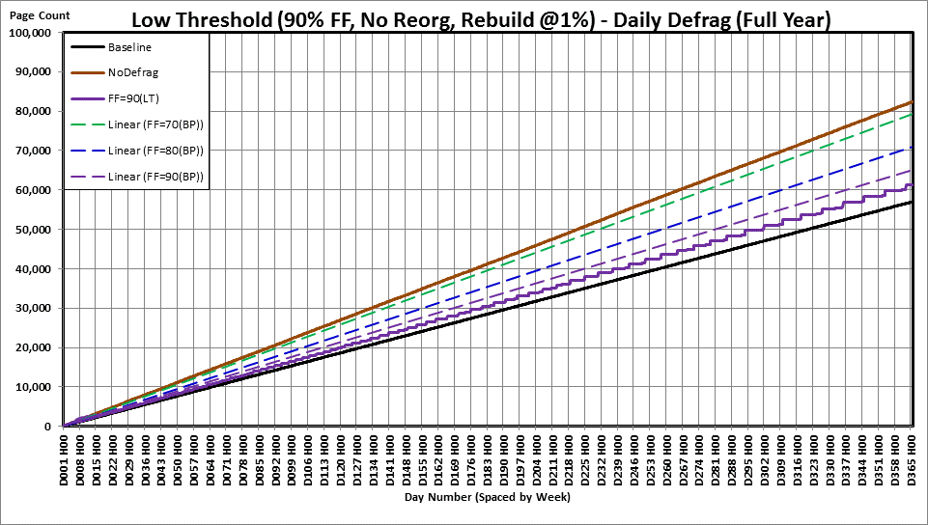
90% Low Threshold Rebuilds (GUIDS & Evenly Distributed)
90% Low Threshold Rebuilds use almost the same memory as 95% BP but have a much longer maintenance span.
Rebuilds occur about 9 days apart here.

Slide 74
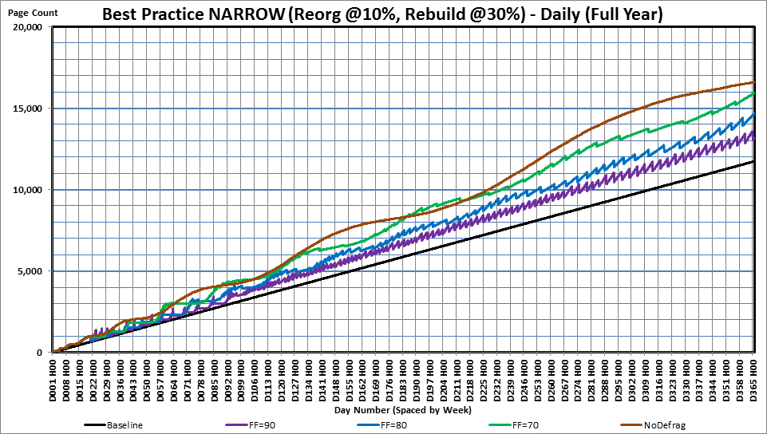
"Best Practice" Narrow Indexes (24 Bytes Wide)
Reorgs require a LOT of index maintenance and it's ALL FULLY LOGGED
Reorgs make it so Page Splits happen EVERY DAY at EVERY FILL FACTOR!

Slide 75
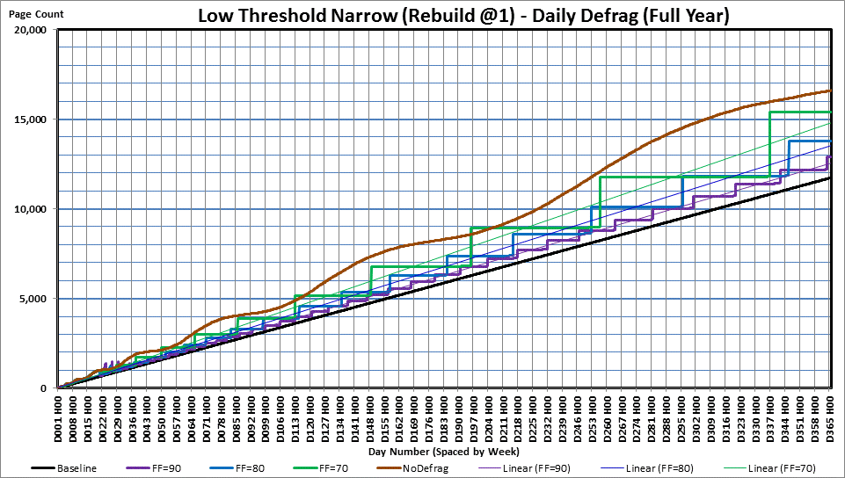
"Low Threshold" Narrow Indexes (24 Bytes Wide)
Low Threshold REBUILDs almost eliminate the need for index maintenance
Low Threshold REBUILDs make it so there are virtually NO PAGE SPLITS for any FILL FACTOR!

Slide 76
"Low Threshold" Narrow Indexes (24 Bytes Wide)
7 Weeks @ FF80
And, remember…
THIS IS WITH A RANDOM GUID AS THE INDEX KEY!
Almost 3 MONTHS@ FF70!
>3 Weeks @ FF90

Slide 77
How do we achieve such a miracle?
Identify the index as a GUID or mostly "Evenly Distributed" index.
Made 4 small changes in how it's defragmented.
Stopped Using Reorganize for this type of index. Only did REBUILDS!
Established a proper fill factor (ends with "1").
Rebuilt as soon as confirmed fragmentation starts to happen @ 1%.
Ran Index Maintenance every night.

Slide 78
Which FILL FACTOR to Use?
All Fill Factors 91% or less
Virtually no page splits
Virtually no fragmentation
Virtually no unnecessary logging
Duration between REBUILDs increases with size of table.
71%
Longest duration between REBUILDs.
Most average memory "waste" (simto almost 80% FF BP)
81%
Long duration between REBUILDs
Less average memory "waste" (simto almost 90% FF BP)
91%
Shortest duration (better than 80% BP)
Least average memory "waste" (simto 95% FF BP)

Slide 79
Quick Review

Slide 80
Quick Review
Bad Page Splits are the primary cause of
Logical Fragmentation.
Physical Fragmentation.
Bad Page Splits are really BAD …
Take a lot of extra time in a System Transaction.
Cause Blocking of SELECTs.
Cause a lot of extra log file activity.
Logical Fragmentation ONLY matters for performance during "Read-Aheads".
Get rid of Bad Page Splits and you get rid of most Fragmentation.
NOT DEFRAGGING IS BETTER THAN REORGANIZING THESE TYPES OF INDEXES BECAUSE IT LEAVES ROOM TO GROW!

Slide 81
And we learned (for GUIDs)…
REORGANIZE has a lot problems...
Take a lot longer than Rebuilds.
Removes critical free space at the worst possible time.
That causes "perpetual" page splits.
That causes "perpetual" fragmentation.
Perpetuates the need for defragmentation.
Current "Best Practice" methods are the source of all these problems.
Low Threshold Rebuilds are the answer.
For GUIDs and Evenly Distributed Indexes.
Virtually eliminates all page splits (good and bad).
Greatly decreases the need for and frequency of Index Maintenance.
Saves memory and disk space.

Slide 82
References

Slide 83
References Basics of Indexes
1. Table and Index Organization
https://technet.microsoft.com/en-us/library/ms189051(v=sql.105).aspx
2. Clustered Index Structures
https://technet.microsoft.com/en-us/library/ms177443(v=sql.105).aspx
3. Nonclustered Index Structures
https://technet.microsoft.com/en-us/library/ms177484(v=sql.105).aspx
4. Reorganize and Rebuild Indexes
https://docs.microsoft.com/en-us/sql/relational-databases/indexes/reorganize-and-rebuild-indexes

Slide 84
References Performance of Indexes
5. ** Definitive MS Article **
https://docs.microsoft.com/en-us/sql/relational-databases/system-dynamic-management-views/sys-dm-db-index-physical-stats-transact-sql
6. How Page Splits Affect the Transaction Log
https://www.sqlskills.com/blogs/paul/how-expensive-are-page-splits-in-terms-of-transaction-log/
7. Performance Considerations of FILL FACTOR
https://docs.microsoft.com/en-us/sql/relational-databases/indexes/specify-fill-factor-for-an-index

Slide 85
References Index Maintenance
8. Index and Stats Maintenance System
https://ola.hallengren.com/sql-server-index-and-statistics-maintenance.html
9. And the guy that started all this…
https://www.brentozar.com/archive/2012/08/sql-server-index-fragmentation/
https://www.brentozar.com/archive/2013/09/why-index-fragmentation-doesnt-matter-video/

Slide 86
More and Suggested Reading
https://www.sqlskills.com/blogs/paul/why-you-should-not-shrink-your-data-files/
https://www.sqlskills.com/blogs/paul/performance-issues-from-wasted-buffer-pool-memory/
https://www.sqlskills.com/blogs/paul/how-expensive-are-page-splits-in-terms-of-transaction-log/ ***
https://www.sqlskills.com/blogs/paul/clustered-or-nonclustered-index-on-a-random-guid/
https://www.sqlskills.com/blogs/kimberly/content/binary/indexesrightbalance-defrag.pdf?59c59e ***
http://aboutsqlserver.com/2013/10/15/sql-server-storage-engine-data-pages-and-data-rows/
https://www.red-gate.com/simple-talk/sql/database-administration/sql-server-storage-internals-101/
https://www.sqlskills.com/blogs/paul/sqlskills-sql101-rebuild-vs-reorganize/
https://www.sqlskills.com/insidercontent/201505/20150511newsletter.pdf
https://www.sqlskills.com/blogs/jonathan/the-accidental-dba-day-14-of-30-index-maintenance/
https://www.sqlskills.com/blogs/paul/inside-the-storage-engine-anatomy-of-a-page/
https://www.sqlskills.com/blogs/paul/inside-the-storage-engine-anatomy-of-a-record/
https://www.sqlskills.com/blogs/paul/easy-automation-of-sql-server-database-maintenance/
https://www.sqlskills.com/blogs/paul/tracking-page-splits-using-the-transaction-log/
https://www.sqlskills.com/blogs/paul/performance-issues-from-wasted-buffer-pool-memory/
https://www.sqlskills.com/blogs/paul/index-rebuilds-depend-on-stats-which-are-updated-by-index-rebuilds/
https://www.sqlskills.com/blogs/paul/importance-of-index-maintenance/
https://www.sqlskills.com/blogs/paul/can-guid-cluster-keys-cause-non-clustered-index-fragmentation/
https://www.sqlskills.com/blogs/paul/a-sql-server-dba-myth-a-day-2530-fill-factor/
http://www.sqlskills.com/insidercontent/commonsqlservermyths.pdf
https://www.sqlskills.com/blogs/kimberly/the-clustered-index-debate-continues/
https://www.sqlskills.com/blogs/paul/conference-questions-pot-pourri-3-unexpected-index-rebuild-results-and-bulk-logged-operations/
https://www.sqlskills.com/blogs/paul/on-index-key-size-index-depth-and-performance/
https://www.sqlskills.com/blogs/paul/inside-the-storage-engine-proof-that-records-are-not-always-physically-stored-in-index-key-order/

Slide 87
Q’n’A
Reminder…
There is a 2nd session and it starts in 15 minutes in this same room!

Slide 88
"Black Arts" Index Maintenance #1
How the “Best Practice” Methods are Silently Killing Performance
Jeff Moden
Thank you for attending ~ and ~ Thank you for what you do!

Slide 89
Extras
Nice to know stuff.

Slide 90
Rebuild, Shrink, Reorganize How they work.
The Only Weapons in a War of Contradictions

Slide 91
Create or Rebuild Clustered Index Full Recovery Model
ONLINE Rebuilds not available in Standard Edition.
Some sorting overhead occurs in MDF depending on fragmentation and can be multi-threaded.
If over 128 Extents (only 8MB), then new index built separately.
Space used doubled in size.
When committed, sort area and old index deallocated to Free Space.
Same for Non-Clustered Rebuilds.
ONLY method to reestablish FILL FACTOR!
Stats for the index are rebuilt in the process.
Old Index/Heap
Free Space
Sort
1
2
3
4
5
6
Note that Create or Disable/Rebuild of NCI causes no extra free space!
Log File

Slide 92
Create or Rebuild Clustered Index Simple/Bulk Logged Recovery Model
Same as when in Full Recovery Model except…
Minimally logged!
Same for Non-Clustered Rebuilds.
Stats for the index are rebuilt in the process.
Old Index
6
Free Space
5
4
3
2
1
Sort
1
2
3
4
5
6
Note that Create or Disable/Rebuild of NCI causes no extra free space!

Slide 93
File Shrink "Inverts" Indexes
Index at "end" of MDF file.
Uses any Free Space at beginning.
Pages are moved from end of file to beginning resulting in descending physical and logical order (inverted).
Known as "Index Inversion"
This is devastating to Read-Ahead performance!!!
Index Maintenance IS REQUIRED afterwards!!!
Free Space
Beginning MDF End
New Index
1
2
3
4
5
6
Log File

Slide 94
Reorganize Any Recovery Model, Any Edition
ONLINE all the time even in Standard Edition.
Defrags using only the space currently occupied + 1 page.
Always fully logged and single threaded.
Huge log file activity w/high fragmentation.
Compacts only when pages are filled < Fill Factor.
Horribly slow w/high fragmentation %
Does NOT rebuild stats.
Will NOT add pages to increase free space on page if filled greater than the Fill Factor.
Does NOT help prevent page splits!!!
8K
Old Index
6
1
5
2
4
3
3
4
2
5
1
6
Log File

